Slide 1
MSBD 5018 - Natural Language Processing
Sentiment Classification
Instructor: Yangqiu Song
Slides credits: Yue Zhang, Dan Roth

Slide 2
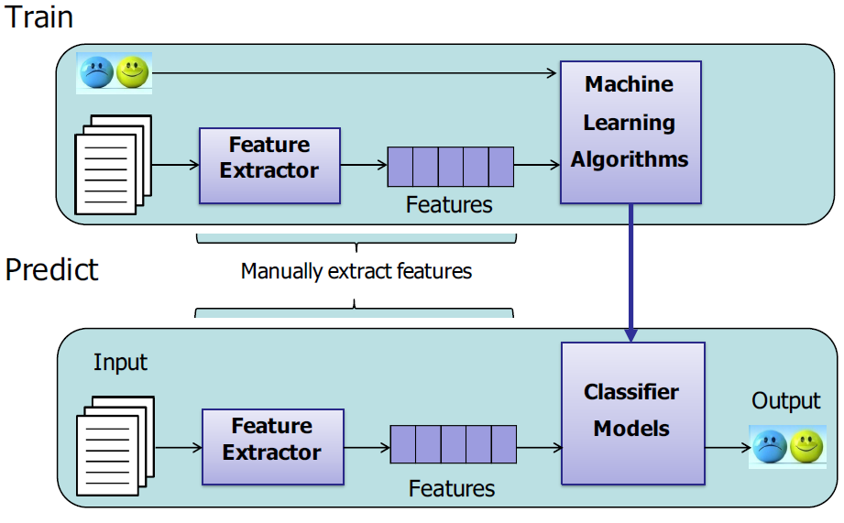
A General Pipeline

Slide 3
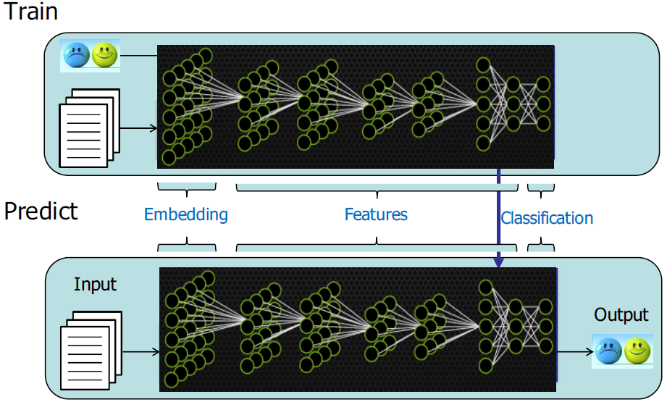
Deep Learning

Slide 4
Deep Learning for Text Classification
Building deep learning models on textual data requires:
Representation of the basic text unit, word.
Neural network structure that can capture the sequential nature of text.
Deep learning models use:
Vector representation of words (i.e., word embeddings)
Neural network structures
Convolutional Neural networks
Recurrent Neural Network
Recursive Neural Network

Slide 5
Overview
General model:

Slide 6
Overview
Embedding Layer
Word to vector
Look up table

Slide 7
Overview
Feature Layer
Automatically learn the representation of inputs
Matrix-vector multiplication
Element-wise composition
Non-linear transformation

Slide 8
Overview
Output Layer
Softmax
Cross-entropy loss

Slide 9
Typical Feature Layers
CNN
RNN

Slide 10
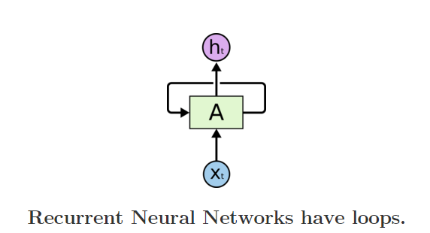
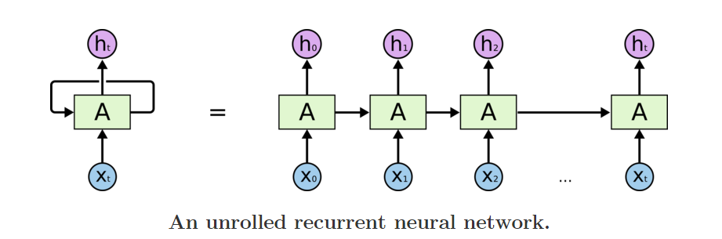
More Notations Used in Papers
Recurrent Neural Networks are networks with loops in them, allowing information to persist.
In the above diagram, a chunk of neural network, A, looks at some input xt and outputs a value ht.
A loop allows information to be passed from one step of the network to the next.
A recurrent neural network can be thought of as multiple copies of the same network, each passing a message to a successor.
The diagram above shows what happens if we unroll the loop.

Slide 11
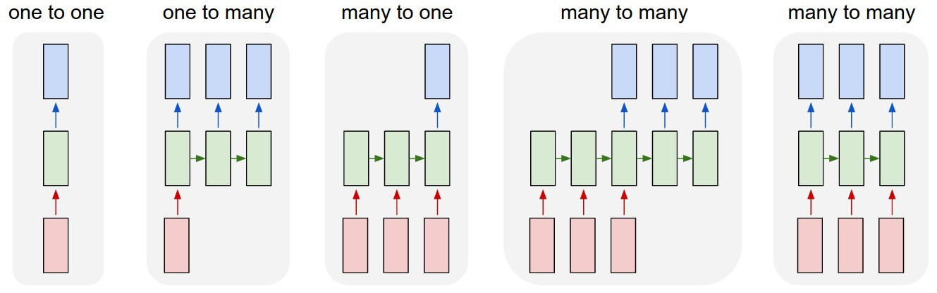
Recurrent Neural Networks
Examples of Recurrent Neural Networks
Each rectangle is a vector and arrows represent functions (e.g. matrix multiply).
Input vectors are in red, output vectors are in blue and green vectors hold the RNN's state
1
2
3
4
5
(1) Standard mode of processing without RNN, from fixed-sized input to fixed-sized output (e.g. image classification).
(2) Sequence output (e.g. image captioning takes an image and outputs a sentence of words).
(3) Sequence input (e.g. sentiment analysis where a given sentence is classified as expressing positive or negative sentiment).
(4) Sequence input and sequence output (e.g. Machine Translation: an RNN reads a sentence in English and then outputs a sentence in French).
(5) Synced sequence input and output (e.g. video classification where we wish to label each frame of the video).

Slide 12
Sentiment Classification
Classify a restaurant review from Yelp! OR movie review from IMDB OR … as positive or negative
Inputs: Multiple words, one or more sentences
Outputs: Positive / Negative classification
“The food was really good”
“The chicken crossed the road because it was uncooked”

Slide 13
Sentiment Classification
RNN
h₁
The

Slide 14
Sentiment Classification
RNN
RNN
h₁
h₂
The
food

Slide 15
Sentiment Classification
h_{n}
RNN
RNN
RNN
h₁
h₂
h_{n-1}
The
food
good

Slide 16


Sentiment Classification
Linear Classifier
h_{n}
RNN
RNN
RNN
h₁
h₂
h_{n-1}
The
food
good

Slide 17
Sentiment Classification
Ignore
Ignore
Linear Classifier
h₁
h₂
h_{n}
RNN
RNN
RNN
h₁
h₂
h_{n-1}
The
food
good

Slide 18
Sentiment Classification
h = Sum(…)
h₁
h_{n}
h₂
RNN
RNN
RNN
h₁
h₂
h_{n-1}
The
food
good
http://deeplearning.net/tutorial/lstm.html

Slide 19
Sentiment Classification
Linear Classifier
h = Sum(…)
h₁
h_{n}
h₂
RNN
RNN
RNN
h₁
h₂
h_{n-1}
The
food
good
http://deeplearning.net/tutorial/lstm.html

Slide 20
Sentiment Classification
Linear Classifier
h'₁
h_{n}
RNN
h’₂
RNN
h'₃
h'_{n}
RNN
h₁
h₂
h_{n-1}
The
food
good
Bi-directional RNN

Slide 21
LSTM
Long short-term memory
Sepp Hochreiter; Jürgen Schmidhuber (1997). "Long short-term memory". Neural Computation. 9 (8): 1735–1780.

Slide 22

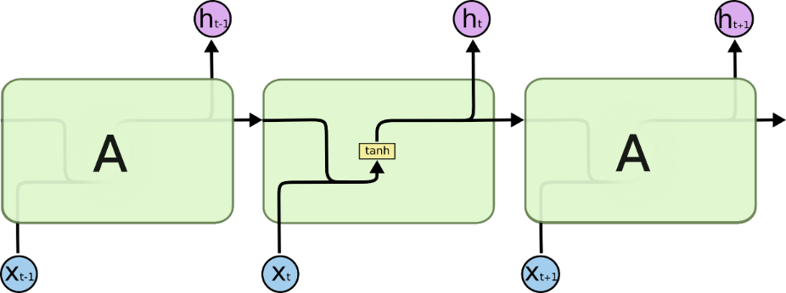

LSTMs also have this chain like structure, but the repeating module has a different structure. Instead of having a single neural network layer, there are four, interacting in a very special way.
http://colah.github.io/posts/2015-08-Understanding-LSTMs/

Slide 23
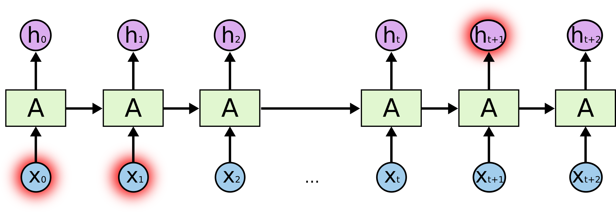
LSTMs are explicitly designed to avoid the long-term dependency problem.
In theory, RNNs are absolutely capable of handling such “long-term dependencies.”
In practice, RNNs don’t seem to be able to learn them.

Slide 24
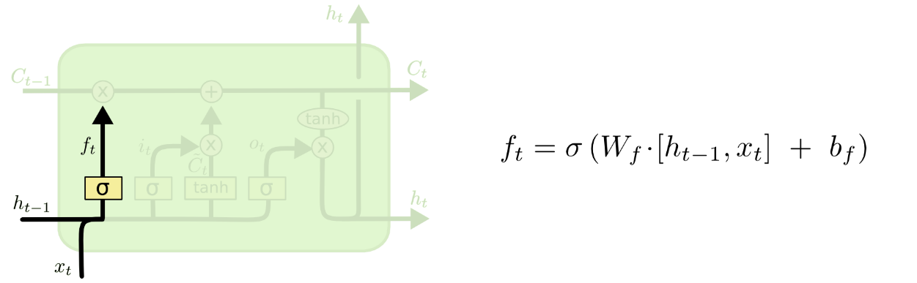
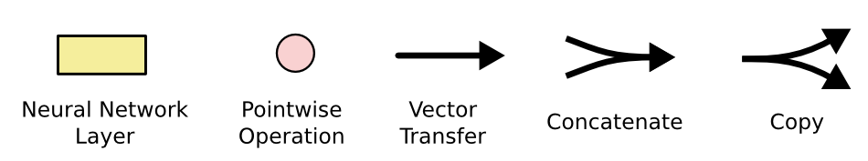
The first step in our LSTM is to decide what information we’re going to throw away from the cell state. This decision is made by a sigmoid layer called the “forget gate layer.” A 1 represents “completely keep this” while a 0 represents “completely get rid of this.”

Slide 25
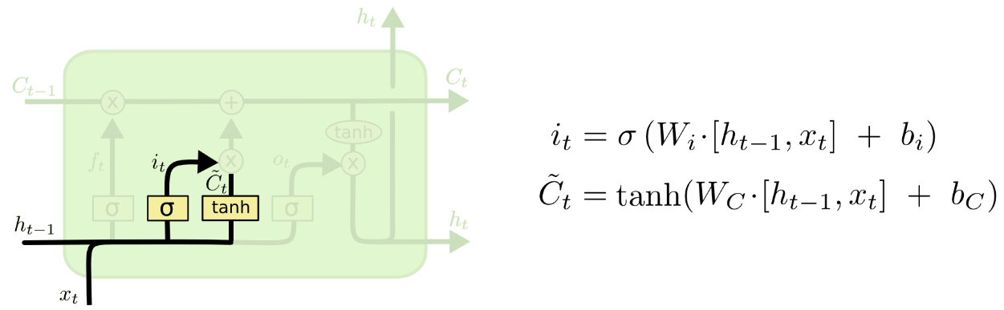
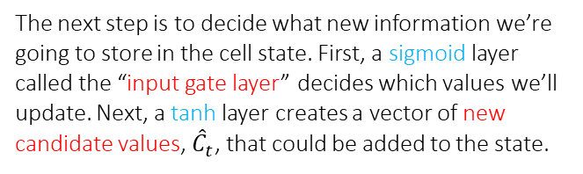
The first step in our LSTM is to decide what information we’re going to throw away from the cell state. This decision is made by a sigmoid layer called the “forget gate layer.” A 1 represents “completely keep this” while a 0 represents “completely get rid of this.”
The next step is to decide what new information we’re going to store in the cell state. First, a sigmoid layer called the “input gate layer” decides which values we’ll update. Next, a tanh layer creates a vector of new candidate values, ${\hat{C}}_{t}$, that could be added to the state.

Slide 26
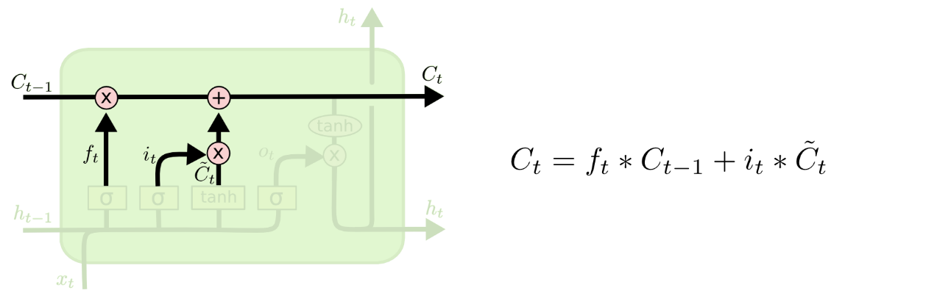
The first step in our LSTM is to decide what information we’re going to throw away from the cell state. This decision is made by a sigmoid layer called the “forget gate layer.” A 1 represents “completely keep this” while a 0 represents “completely get rid of this.”
The next step is to decide what new information we’re going to store in the cell state. First, a sigmoid layer called the “input gate layer” decides which values we’ll update. Next, a tanh layer creates a vector of new candidate values, ${\hat{C}}_{t}$, that could be added to the state.
We multiply the old state, forgetting the things we decided to forget earlier.
The new candidate values to add is scaled by how much we decided to update each state value.

Slide 27
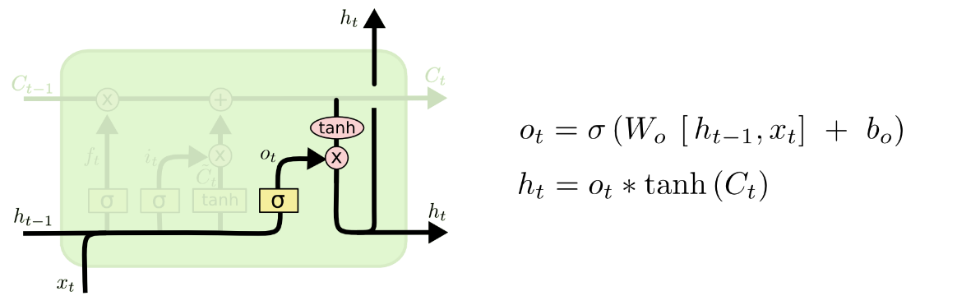
Finally, we need to decide what we’re going to output.
This output will be based on our cell state, but will be a filtered version.
First, we run a sigmoid layer which decides what parts of the cell state we’re going to output.
Second, we put the cell state through tanh (to push the values to be between −1 and 1) and multiply it by the output of the sigmoid gate, so that we only output the parts we decided to.

Slide 28
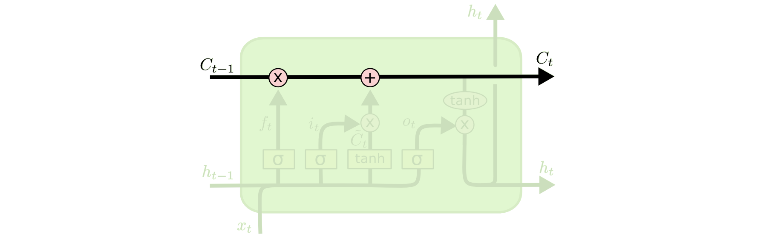
The Core Idea Behind LSTMs
The key to LSTMs is the cell state, the horizontal line running through the top of the diagram.
Notes:
The cell state is kind of like a conveyor belt. It runs straight down the entire chain, with only some minor linear interactions. It’s very easy for information to just flow along it unchanged.

Slide 29
Limitation of RNNs
Recurrent Neural Networks are unique as they allow us to operate over sequences of vectors.
Sequences in the input, the output, or in the most general case both

Slide 30
Recursive Neural Networks
Given the structural representation of a sentence, e.g. a parse tree:
Recursive Neural Networks recursively generate parent representations in a bottom-up fashion,
By combining tokens to produce representations for phrases, eventually producing the whole sentence.
The sentence-level representation (or, alternatively, its phrases) can then be used to make a final classification for a given input sentence — e.g. whether it conveys a positive or a negative sentiment.

Slide 31
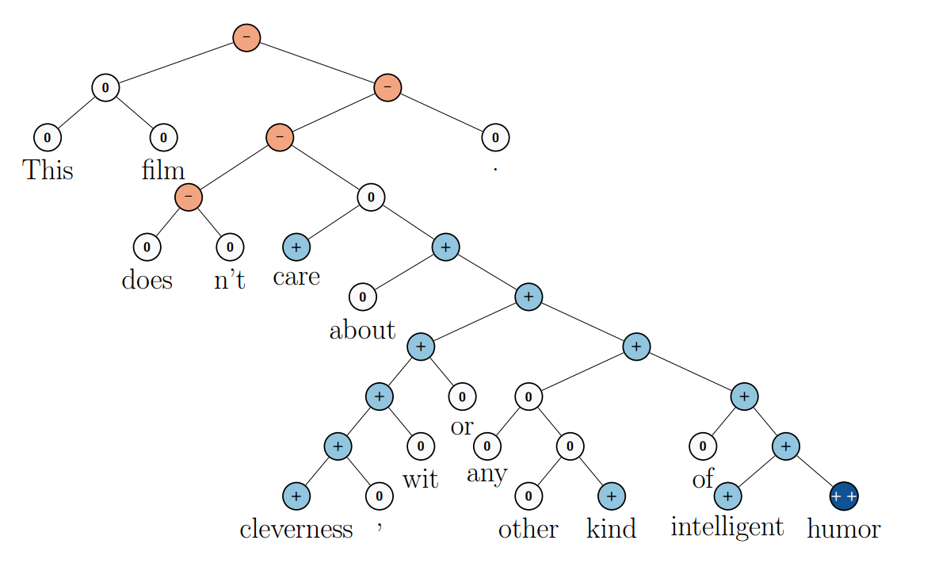
Recursive Neural Networks
Recursive neural networks have had significant successes in a number of NLP tasks.
Socher et al. (2013) uses a recursive neural network to predict sentence sentiment:
Richard Socher, Alex Perelygin, Jean Y. Wu, Jason Chuang, Christopher D. Manning, Andrew Y. Ng, and Christopher Potts. 2013. Recursive deep models for semantic compositionality over a sentiment treebank. In Proceedings of EMNLP , 1631-1642.

Slide 32
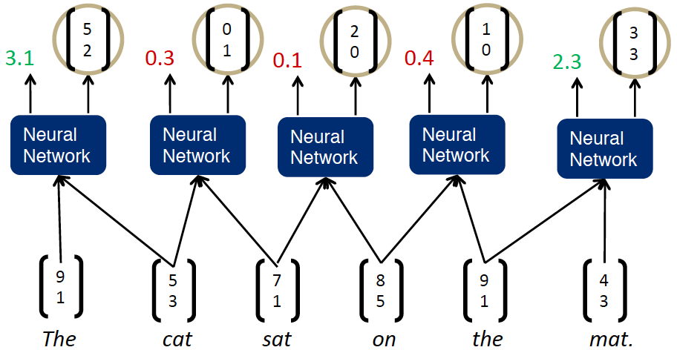
Recursive Neural Network Illustration (Animation)

Slide 33
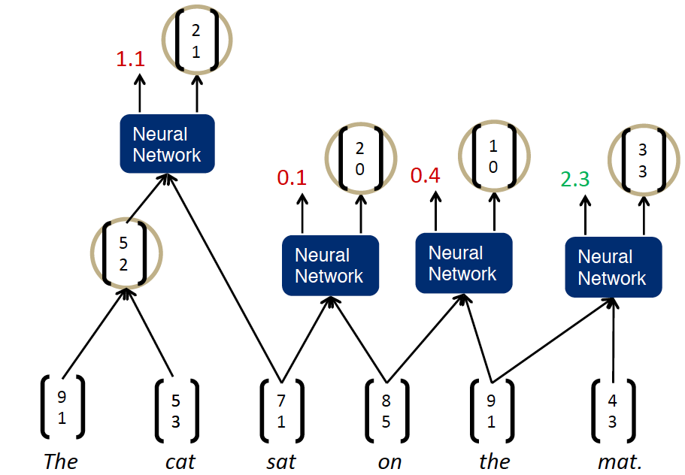
Recursive Neural Network Illustration (Animation)

Slide 34
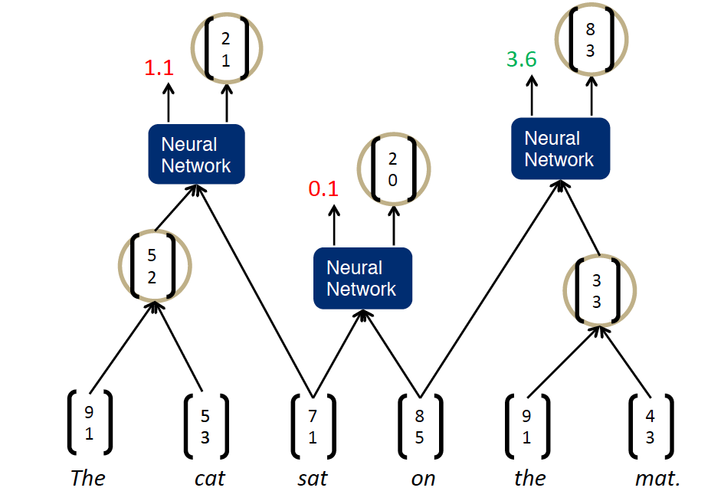
Recursive Neural Network Illustration (Animation)

Slide 35
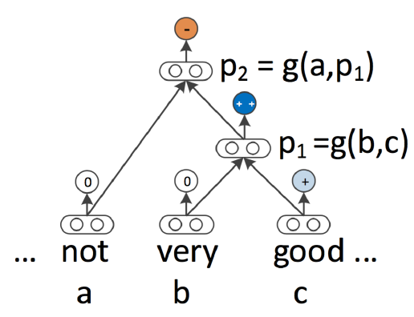
Recursive Neural Network Component

Slide 36
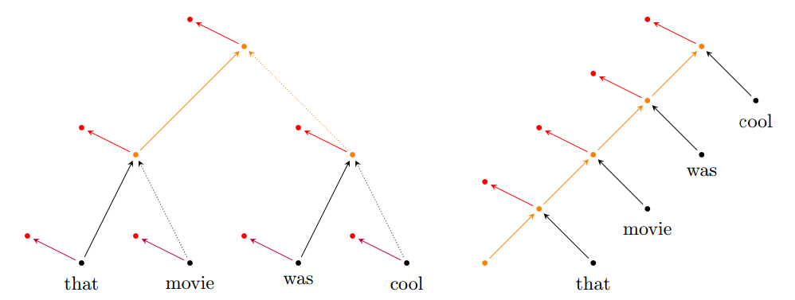
A recursive NN can be seen as a generalization of the recurrent NN
A recurrent neural network is in fact a recursive neural network with the structure of a linear chain
Recursive NNs operate on hierarchical structure, Recurrent NN operate on progression of time
Applied to parsing, sentence-level sentiment analysis, and paraphrase detection.
Operation of a recursive net (a), and a recurrent net (b) on an example sentence. Note the linear chain in (b)
Black, orange and red dots represent input, hidden and output layers, respectively.
Directed edges having the same color-style combination denote shared connections.

Slide 37
http://nlp.stanford.edu:8080/sentiment/rntnDemo.html

Slide 38
Other Variants
How to deal with long documents?
Recurrent Neural Network
Disadvantage: “a biased model, where later words are more dominant than earlier words”
Convolutional Neural Network
Advantages:
capture the semantic of texts better than recursive or recurrent NN.
Time complexity of CNN is O(n).
Disadvantages:
It is difficult to determine the window size

Slide 39
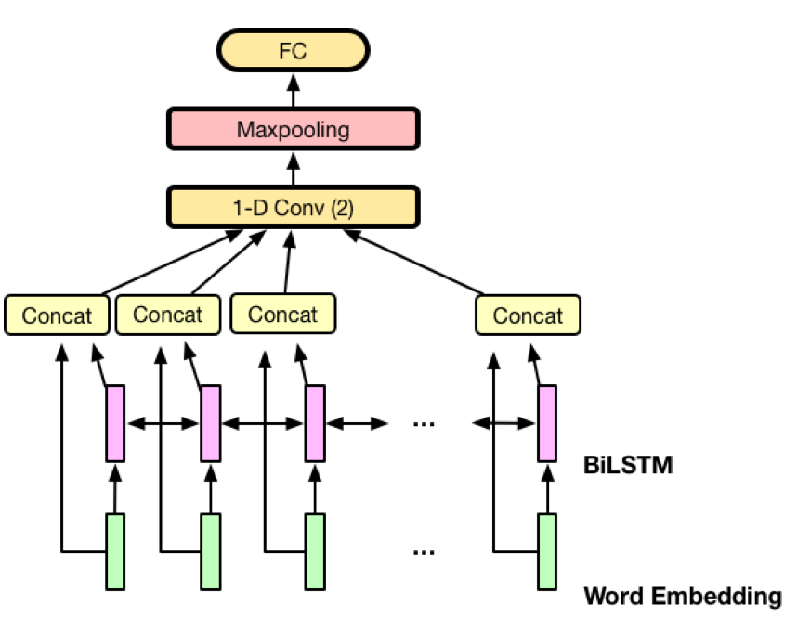
Other Variants (RNN+CNN)
RNN+CNN
Also, connect embeddings to hidden

Slide 40
Benchmarks
Movie reviews
Pang and Lee (2004)
Subjectivity vs Objectivity sentences
Positive vs Negative document
Bo Pang and Lillian Lee. 2004. A sentimental education: sentiment analysis using subjectivity summarization based on minimum cuts. In Proceedings of ACL. 9

Slide 41
Benchmarks
Movie reviews
Pang and Lee (2005)
Sentence-level
Bo Pang and Lillian Lee. 2005. Seeing stars: Exploiting class relationships for sentiment categorization with respect to rating scales. In Proceedings of ACL, 115-124.

Slide 42
Benchmarks
Movie reviews
Mass et al. (2011)
Document-level
Andrew L. Maas, Raymond E. Daly, Peter T. Pham, Dan Huang, Andrew Y. Ng, and Christopher Potts. 2011. Learning word vectors for sentiment analysis. In Proceedings of ACL:HLT, 142-150.

Slide 43
Benchmarks
Movie reviews
Socher et al. (2013), which is induced from Pang and Lee (2005)
Phrase-level
Richard Socher, Alex Perelygin, Jean Y. Wu, Jason Chuang, Christopher D. Manning, Andrew Y. Ng, and Christopher Potts. 2013. Recursive deep models for semantic compositionality over a sentiment treebank. In Proceedings of EMNLP , 1631-1642.
Bo Pang and Lillian Lee. 2005. Seeing stars: exploiting class relationships for sentiment categorization with respect to rating scales. In Proceedings of ACL, 115-124. 12

Slide 44
Benchmarks
Product reviews
Hu and Liu (2004): 5 products
Ding et al (2008): 9 products, which is induced from Hu and Liu (2004)
Fine-grained
Minqing Hu and Bing Liu. 2004. Mining and summarizing customer reviews. In Proceedings of ACM SIGKDD KDD, 168-177.
Xiaowen Ding, Bing Liu, and Philip S. Yu. 2008. A holistic lexicon-based approach to opinion mining. In Proceedings of WSDM, 231-240.
Minqing Hu and Bing Liu. 2004. Mining and summarizing customer reviews. In Proceedings of ACM SIGKDD KDD, 168-177.

Slide 45
Benchmarks
Twitter
Go et. al. (2009)
Sentence-level
Alec Go, Richa Bhayani, and Lei Huang. 2009. Twitter sentiment classification using distant supervision. CS224N Project Report, Stanford , 12.

Slide 46
Benchmarks
Twitter
Mitchell et. al. (2013)
Open domain
Margaret Mitchell, Jacqui Aguilar, Theresa Wilson, and Benjamin Van Durme. 2013. Open domain targeted sentiment. In Proceedings of EMNLP, 1643–1654.

Slide 47
Benchmarks
Twitter
Dong et. al. (2014)
Targeted
Li Dong, Furu Wei, Chuanqi Tan, Duyu Tang, Ming Zhou and Ke Xu. 2014. Adaptive Recursive Neural Network for Target-dependent Twitter Sentiment Classification. In Proceedings of ACL, 49-51.

Slide 48
Benchmarks
Twitter
SemEval13 (Nakov et. al., 2013)
Sentence-level
Preslav Nakov, Sara Rosenthal, Zornitsa Kozareva, Veselin Stoyanov, Alan Ritter, and Theresa Wilson. 2013. SemEval-2013 task 2: Sentiment analysis in Twitter. In Proceddings of SemEval, 312–320.

